Slide 1
Vectorization Over Python Loop

Slide 2

Content
Introduction
Vectorization
NumPy Vectorization
Conclusion

Slide 3

A loop is a control flow statement that enables the execution of code to be repeated depending on a condition. In any programming language, commonly used types of loops are "for" loops and "while" loops. Loops iterate over elements individually and carry out operations on each element in a specific order. Although loops are adaptable and capable of handling intricate iterative tasks, they tend to be slower, particularly when dealing with extensive datasets. This is due to the additional processing required for each iteration, and the interpreter not being as optimized for iterative execution as it is for vectorized operations. Alternatively, Vectorization enables the execution of an operation on each element of a vector without the need for explicitly coding a loop. This approach not only enhances conciseness but also generally leads to quicker execution.
Introduction

Slide 4
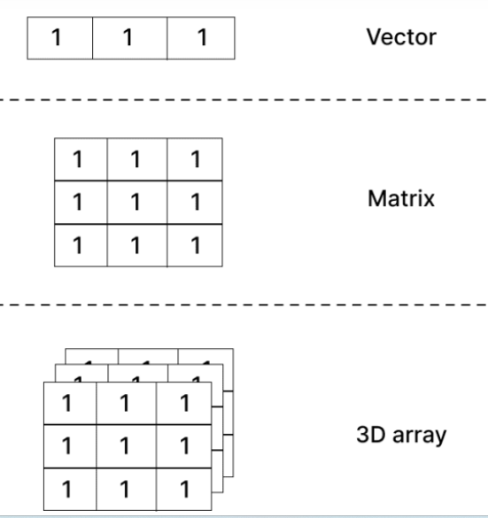
Vectorization
Vectorization is a method that enables quicker computation through the storage and manipulation of data in an array or vector format, as opposed to individual units. The primary framework for storing and manipulating data in a vectorized manner is the N-dimensional array, also known as the ND array. This data structure serves as a representation of a multi-dimensional grid of values.

Slide 5
NumPy Vectorization
Extensive memory usage: Python numerical values and the assistance provided by NumPy.
NumPy vectorization allows for the execution of mathematical operations across entire arrays, removing the necessity of iterating through each element individually. NumPy arrays do not store references to Python objects like regular Python lists do, which helps to avoid the overhead associated with storing each number in the array. Instead, NumPy arrays store the numbers directly, eliminating the need for additional memory allocation.

Slide 6
Conclusion
Utilizing vectorization instead of explicit For Loops when appropriate can enhance the robustness of our upcoming project as it provides a faster method for performing calculations. However, there are instances where the use of Loops is unavoidable. It is crucial to make a thoughtful decision by carefully examining the specific problem at hand. If the problem can be effectively solved in a parallel manner, transitioning to vectorization is the optimal choice.
GitHub: https://github.com/ds-stratgic-work/Vectorization-over-Loop.git

Slide 7


Thank You
dSights is a data tech specialist with a vision to create value through:
Outcome-Oriented AI
Fueled by
Innovative Experimentation

